Slide 1
Capstone Project - The Battle of Neighbourhoods Report
HOUSE PRICE PREDICTION IN CENTRAL TORONTO
Lakshmi sri sai, august 2020

Slide 2
Background
This project will help in such cases like prediction of houses with nearby facilities around their neighborhood in in Central Toranto.This project will people to get awareness of the area and neighborhood before moving to a new city, state, country or place for their work or to start a new fresh life.
This Project include analysis of features for a people migrating to North york to search a best neighborhood. The features include median housing price and better school according to ratings, crime rates of that particular area, road connectivity, weather conditions, medical facailities for emergency, water resources both fresh and waste water etc

Slide 3
Problem
sorting the list of houses with nearby better facilities
2. finding the best house in central toronto neighbourhoods

Slide 4
Source of datas
The first data source of the project uses a List of postal codes of Canada("https://en.wikipedia.org/wiki/List_of_postal_codes_of_Canada:_M") that shows the borough and neighbourhoods in central toronto. The dataset contains the following columns:
The second source of data is scraped from a wikipedia page that contains the list of latitudes and longitudes for boroughs(https://cocl.us/Geospatial_data). This page contains additional information about the boroughs, the following are the columns:
The third data source is the list of venues in Canada around their boroughs found from Foursquare API . This dataset contains the following coloumns:

Slide 5
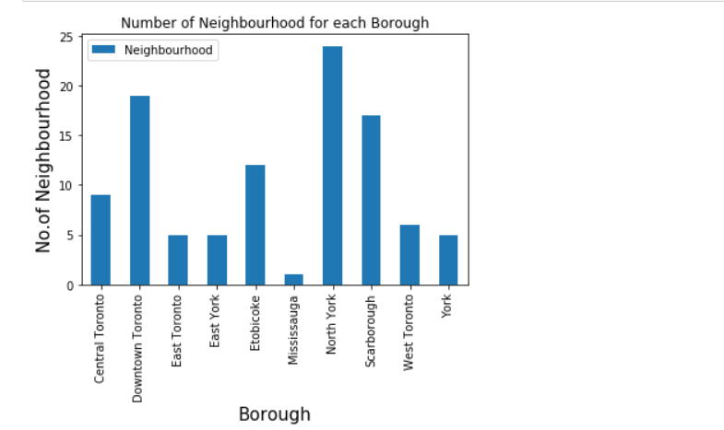

Slide 6
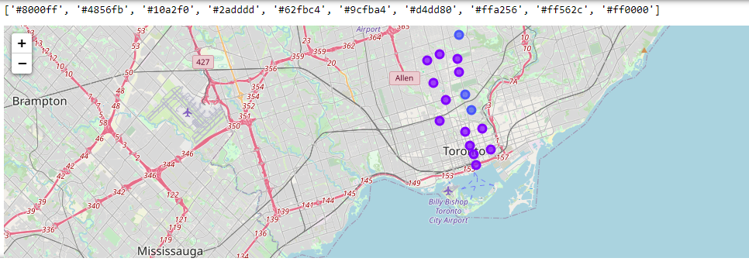
Map of clusters

Slide 7
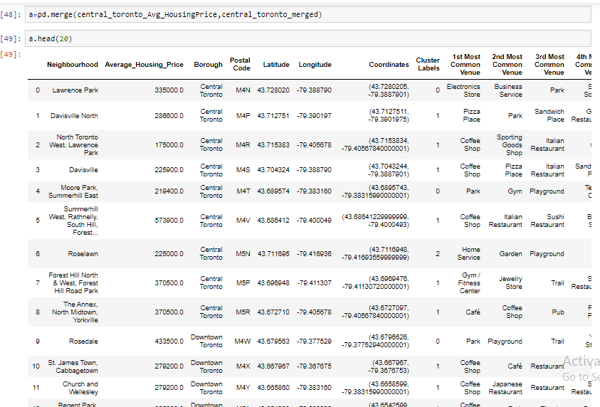
Prices of each neighbourhood in their boroughs

Slide 8
result
From 9 neighbourhoods in central totonto we analyse the prices at eac neighbourhood with suitable facilities among them top 3 best places are
1. North Toronto West, Lawrence Park-175000.0-Central Toronto
2. Roselawn-225900.0-Central Toronto
3. Davisville-225900.0-Central Toronto

